Slide 1

INTELLIGENT SONAR SYSTEM
Team members :
SAKTHIMURUGAN S
MUGUNTHANBALAJI B
BABUGANESH M
Project Guide :
Mr. K.SATHISH

Slide 2
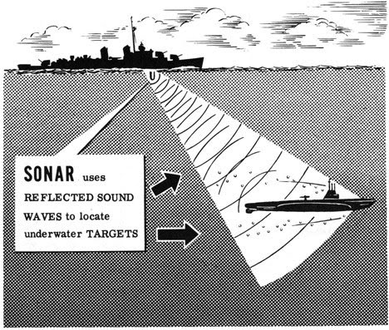
ABSTRACT
This project presents an intelligent SONAR-based prototype using ultrasonic sensing and machine learning to enhance basic object detection with behavioral analysis. The system continuously collects real-time ultrasonic data using an Arduino-based setup and analyzes variations in the reflected signals over time. Based on these patterns, the system performs a simple behavior-level classification and reports detection results with confidence awareness. A voice-based assistant is integrated to provide real-time audio updates, reducing the need for continuous visual monitoring. The proposed prototype demonstrates how low-cost ultrasonic sensors can be combined with decision support, and voice reporting to support monitoring and surveillance tasks in controlled, short-range environments.

Slide 3
Existing Systems & Drawbacks
Conventional ultrasonic and basic SONAR systems are primarily used for object detection and distance measurement.
These systems typically indicate only the presence of an object, without providing additional behavioral insight.
Interpretation of detected objects often relies on continuous human monitoring.
Most low-cost systems lack built-in intelligence for automated analysis and decision support.
Many advanced SONAR systems are physically large, heavy, and require higher power, making them unsuitable for small boats and compact platforms.
As a result, small vessels often rely on basic sensing systems without intelligent reporting or alerts.

Slide 4
Module description
1. Hardware Setup
Ultrasonic sensors , servo motor and an Arduino are used to detect nearby objects.
2. Data Collection & Model Training
Collect real-time data from sensors. The collected data is processed and used to train a machine learning model to classify object behavior.
3. AI Voice Assistant
The system provides real-time voice alerts to report detected object behavior.
4. UI Integration
A Interactive user interface displays live detection ,classification results with Voice assistant.

